Slide 1

So you're moving to microservices
A guide to success and patterns that will save your butt

Slide 2








We are exceptional at:
ADVISORY SERVICES
APPLICATION DEVELOPMENT
MOBILE SOLUTIONS
DATA & ANALYTICS
We’re an IT solutions company that solves tough technology challenges so you can get back to business better than usual.
INTERNET OF THINGS
APPLICATION MANAGEMENT
TESTING SERVICES
PLATFORM SERVICES

Slide 3






About Me
I have been developing software commercially for the last 15 year. In my free time I enjoy mixing live music for local Louisville bands, making movies, and developing video games.
https://github.com/cdwaddell
https://www.linkedin.com/in/cdwaddell
@cdanielwaddell

Slide 4



Microservices… Go!

Slide 5
Why switch?
Microservices are the future right
Easily maintained dependency trees
Segregation of responsibility
Easier to understand and consumable packages of code
Scalability
Better release management
Improved resiliency
Notes:
Why switch to microservices?

Slide 6
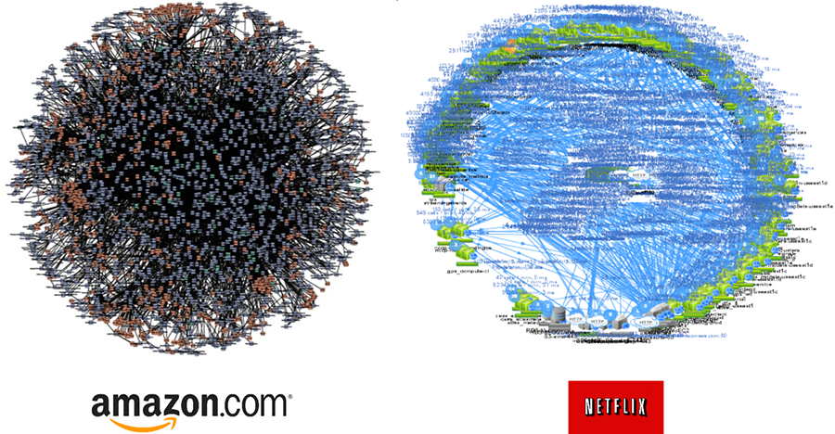
Planning your microservices
Figure out all of your cross cutting concerns first
Debugging
Security
Versioning
Logging
Discovery
https://www.appcentrica.com/wp-content/uploads/2016/11/Microservices-Architecture-1.png
Notes:
Planning and preparation:
Security – I recommend using user tokens over server tokens
Versioning – You have to think about versioning before you start your journey
Logging – Log the world

Slide 7

What does this have to do with saving my butt?
Notes:
Overview of technologies

Slide 8
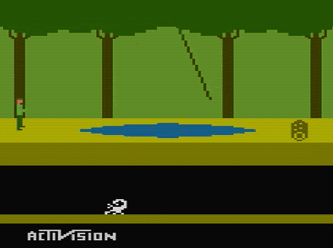

Common problems that hit too late
Needing better logs after your first major bug.
Poor domain boundaries.
Recovering form problems.
Resource exhaustion.
Domain complexity surpasses architecture.

Slide 9

Logging
& Debugging

Slide 10
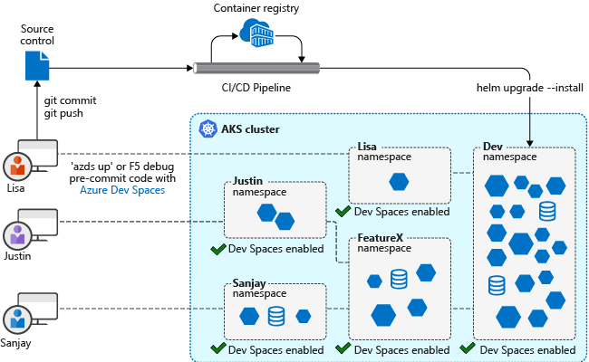
Make Debugging Easy
Microservices have huge overheads
Local development shouldn’t come with the overhead of running everything.
Service Discovery should be customizable.
Take a lesson from Azure Dev Spaces

Slide 11
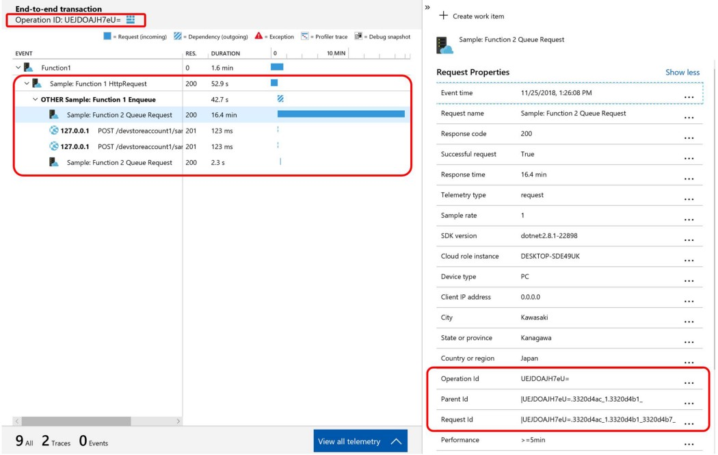
Correlated Telemetry
Follow the execution path in your software
Consistent Telemetry Timing.
Store Parent ID and Root ID for aggregate views.
Originating application metadata
Originating container metadata
Notes:
Logging over view with correlation

Slide 12
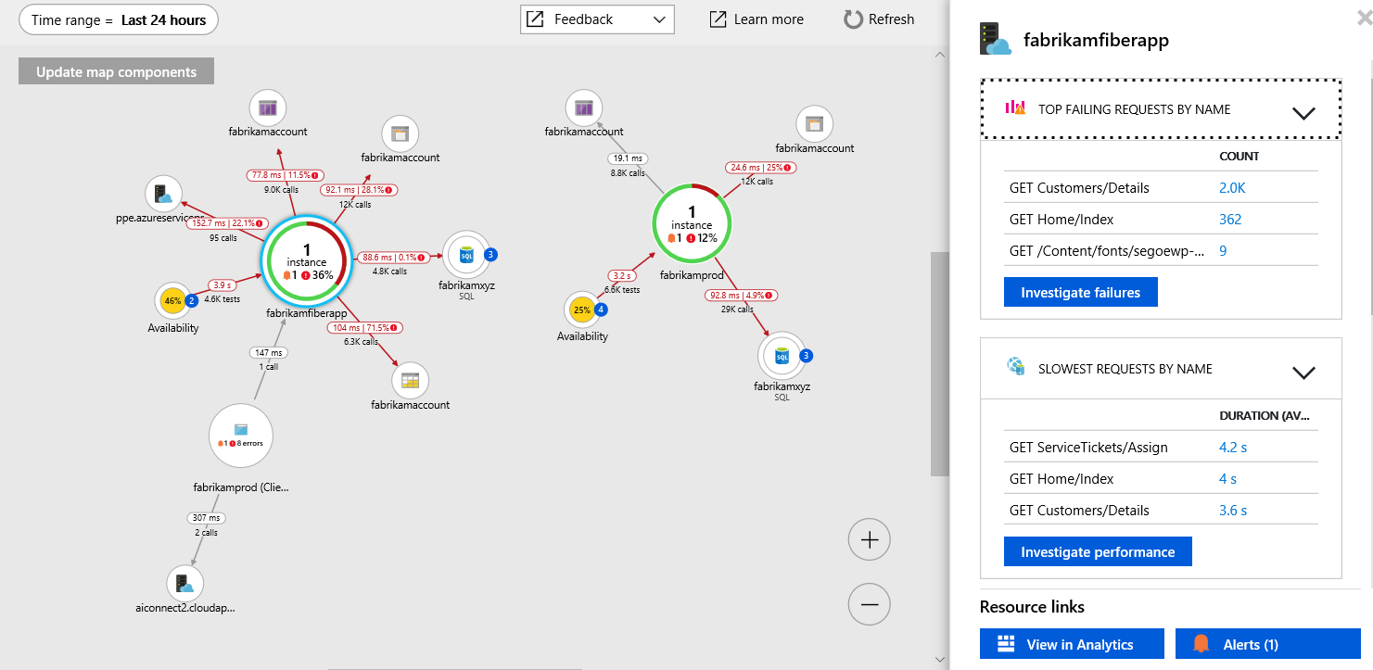

Slide 13
Code
Notes:
CorrelationTelemetry
Program
Startup

Slide 14
Domain Complexity

Slide 15
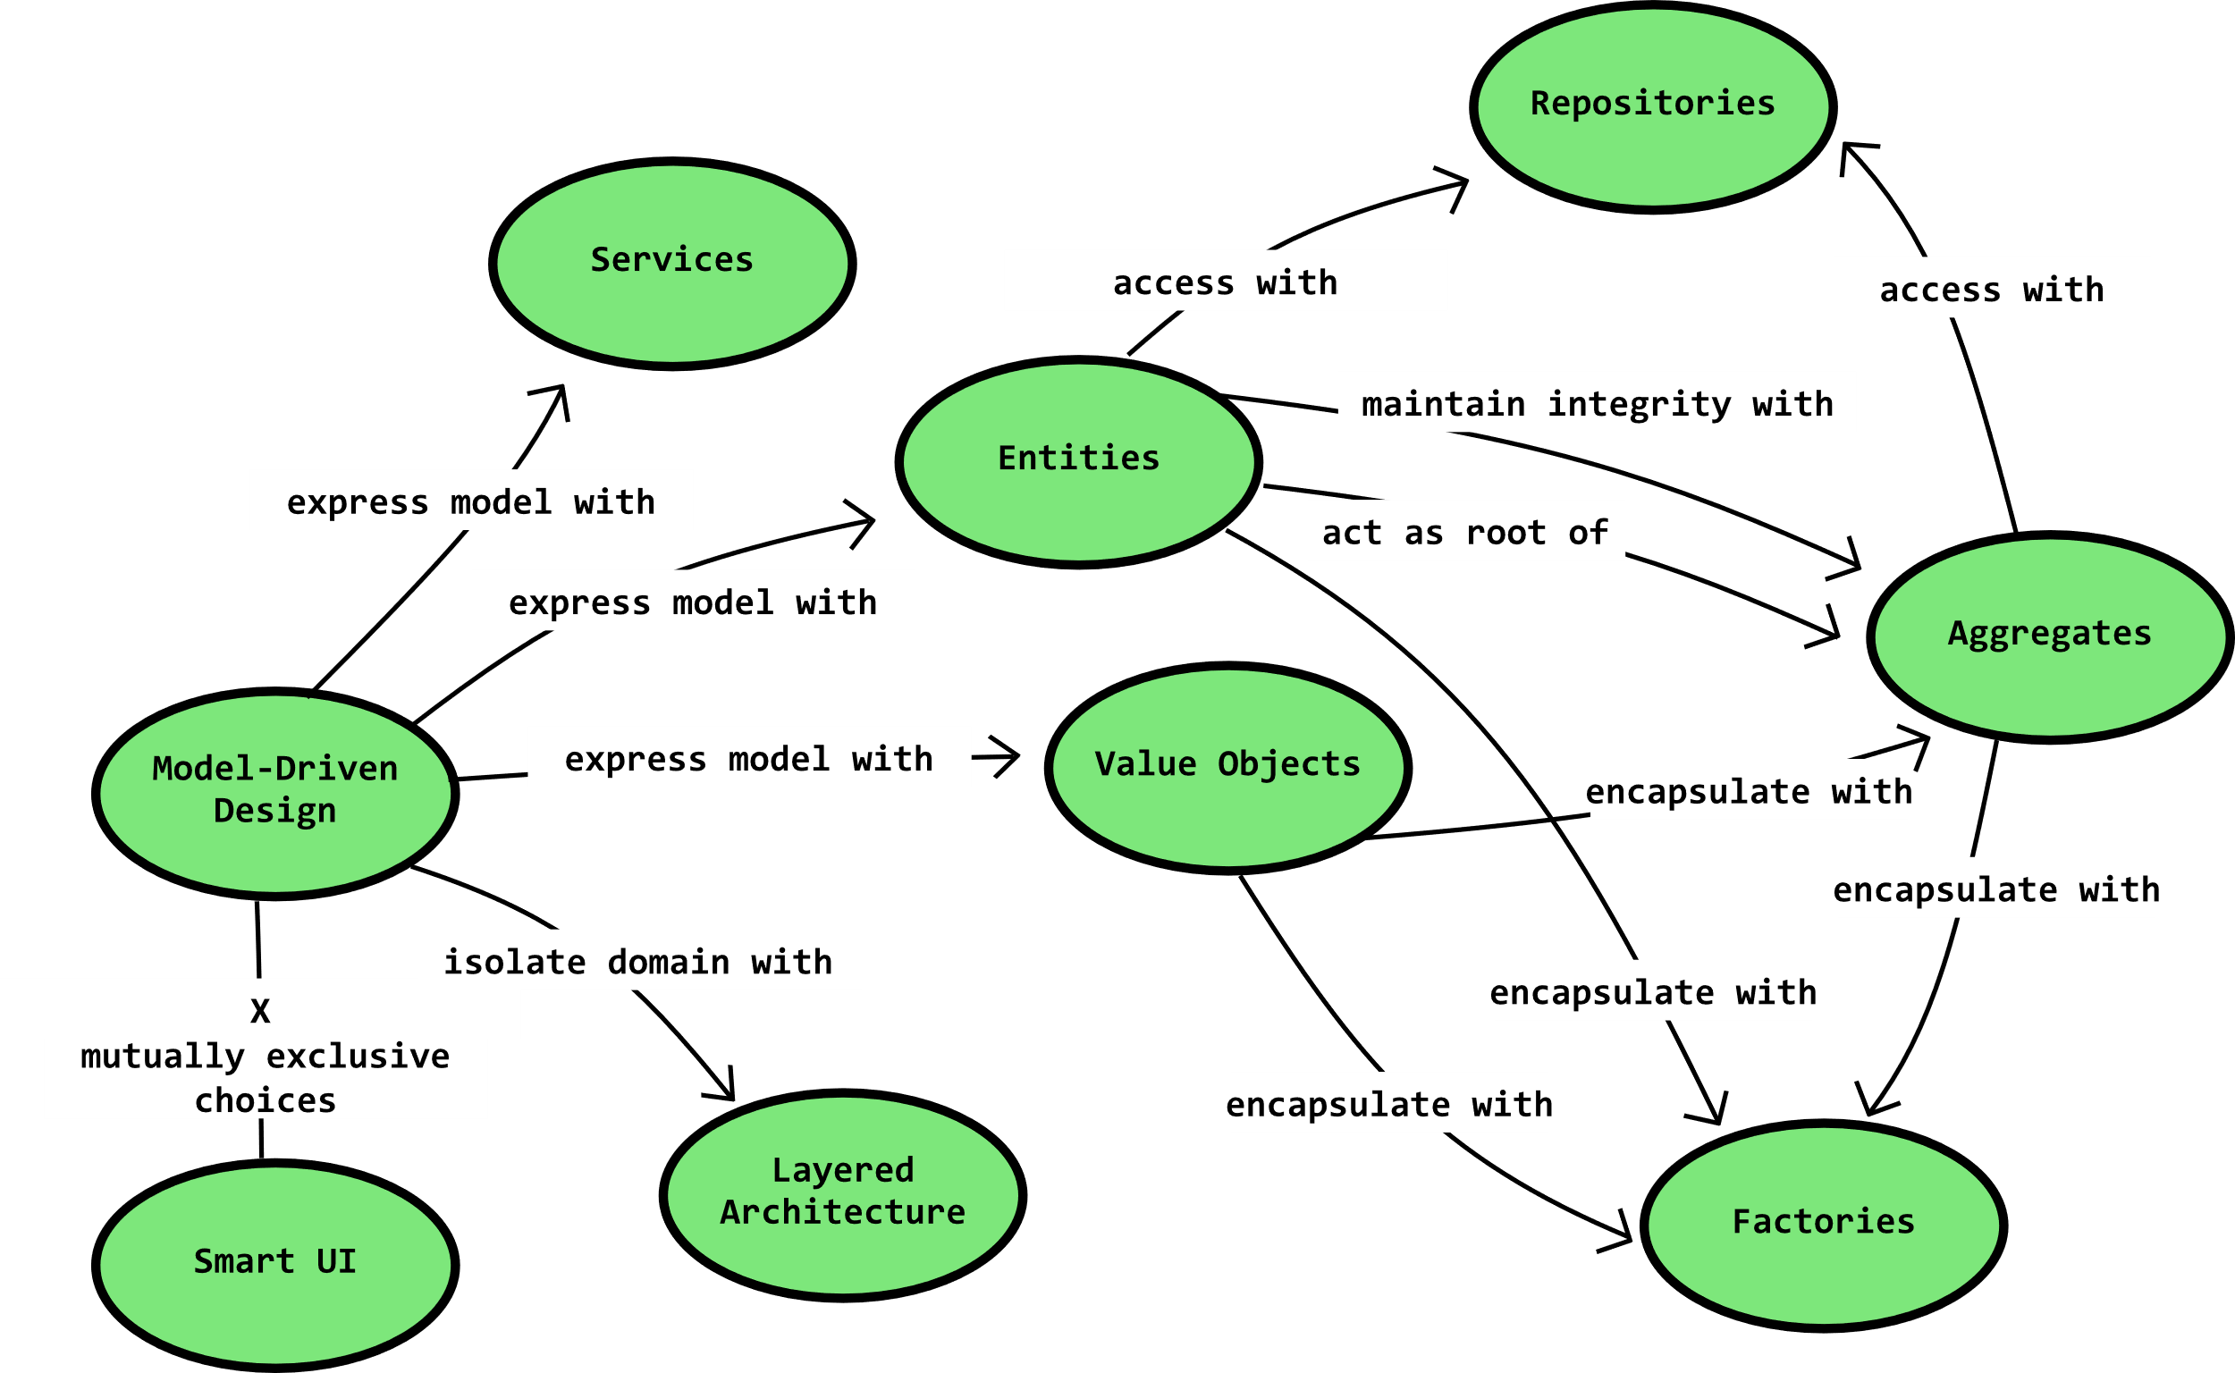
Notes:
Micro APIs

Slide 16
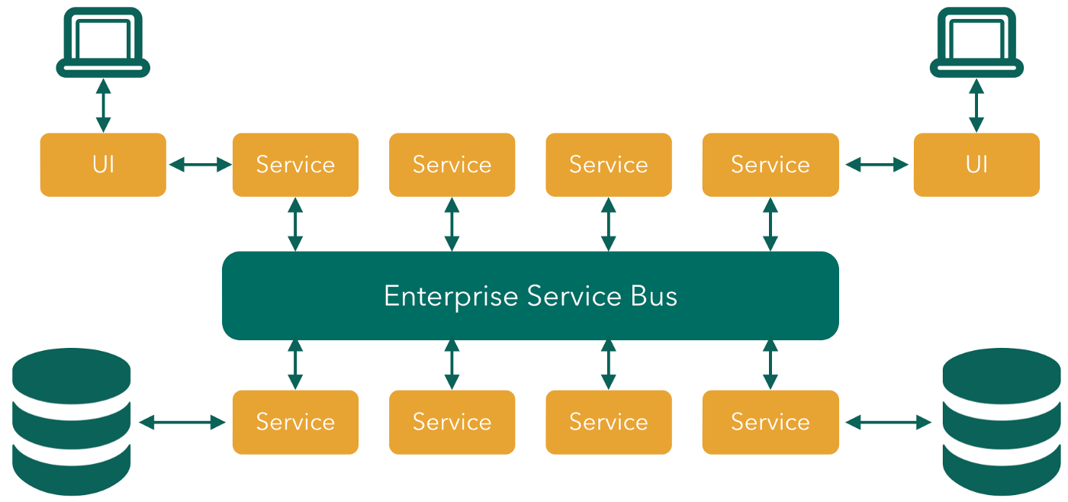
Sometimes domain boundaries don’t fit
Notes:
APIs need to communicate

Slide 17
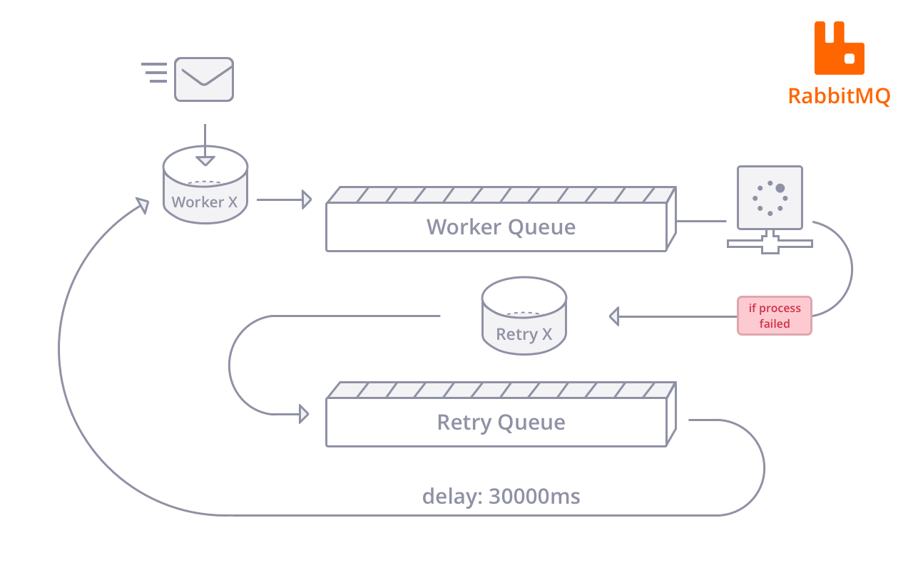
Notes:
Message queing required read with acknowledgement

Slide 18
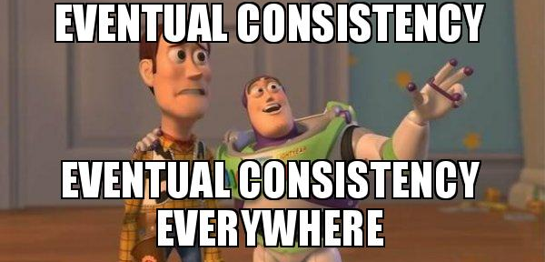
Notes:
Eventual consistency

Slide 19
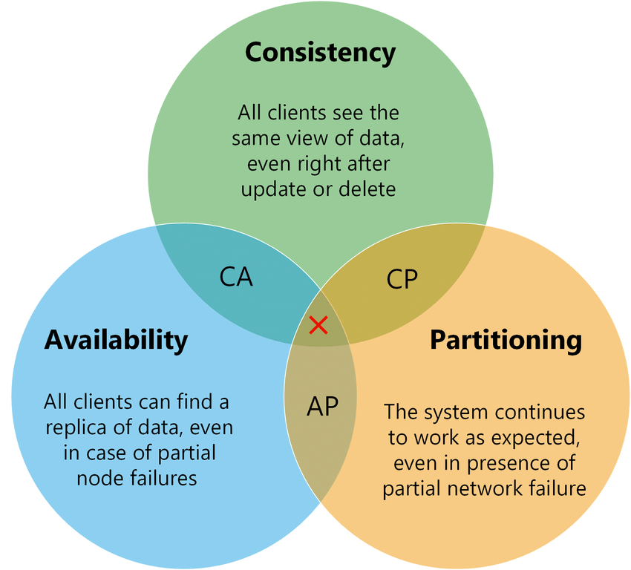
Notes:
CAP Theorem

Slide 20
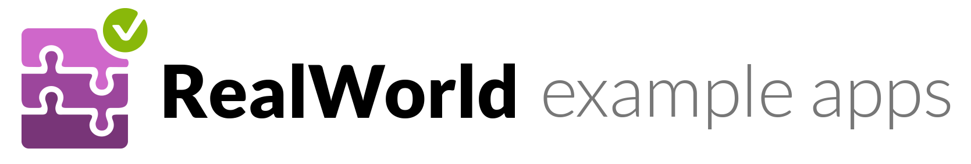

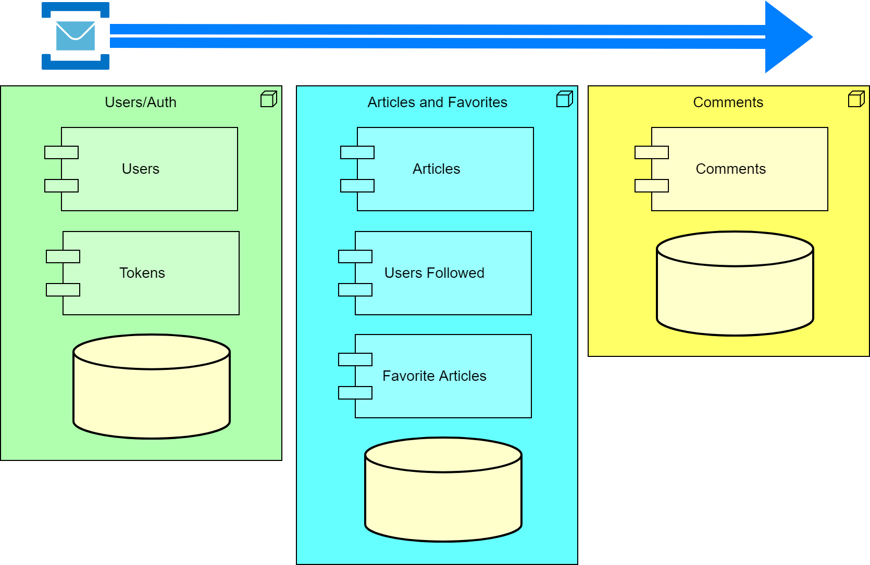
https://github.com/mchandleraz/realworld-vue

Slide 21
Code
Notes:
UpdateUserBus
UserUpdated
EventBusRabbitMQ
EventBusServiceBus

Slide 22
Recovery

Slide 23

Concepts to know
Recovering from problems is core to cloud and distributed computing.
Fail fast(ish)
Circuit breakers on integration.
Retries with exponential back-offs.
Bulkhead throttles on systems.
Notes:
Retry with exponential backoff
Circuit Breaker
Bulkhead

Slide 24
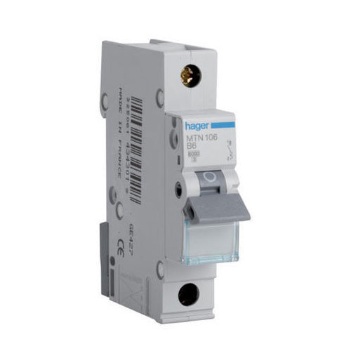
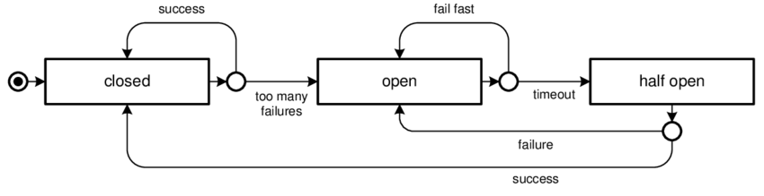
Circuit Breaker

Slide 25
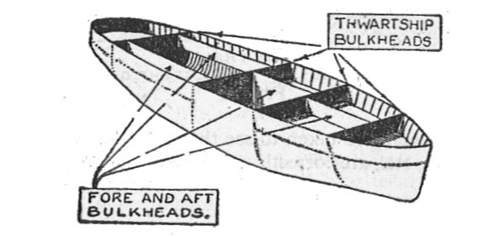
Bulkhead Interceptor

Slide 26

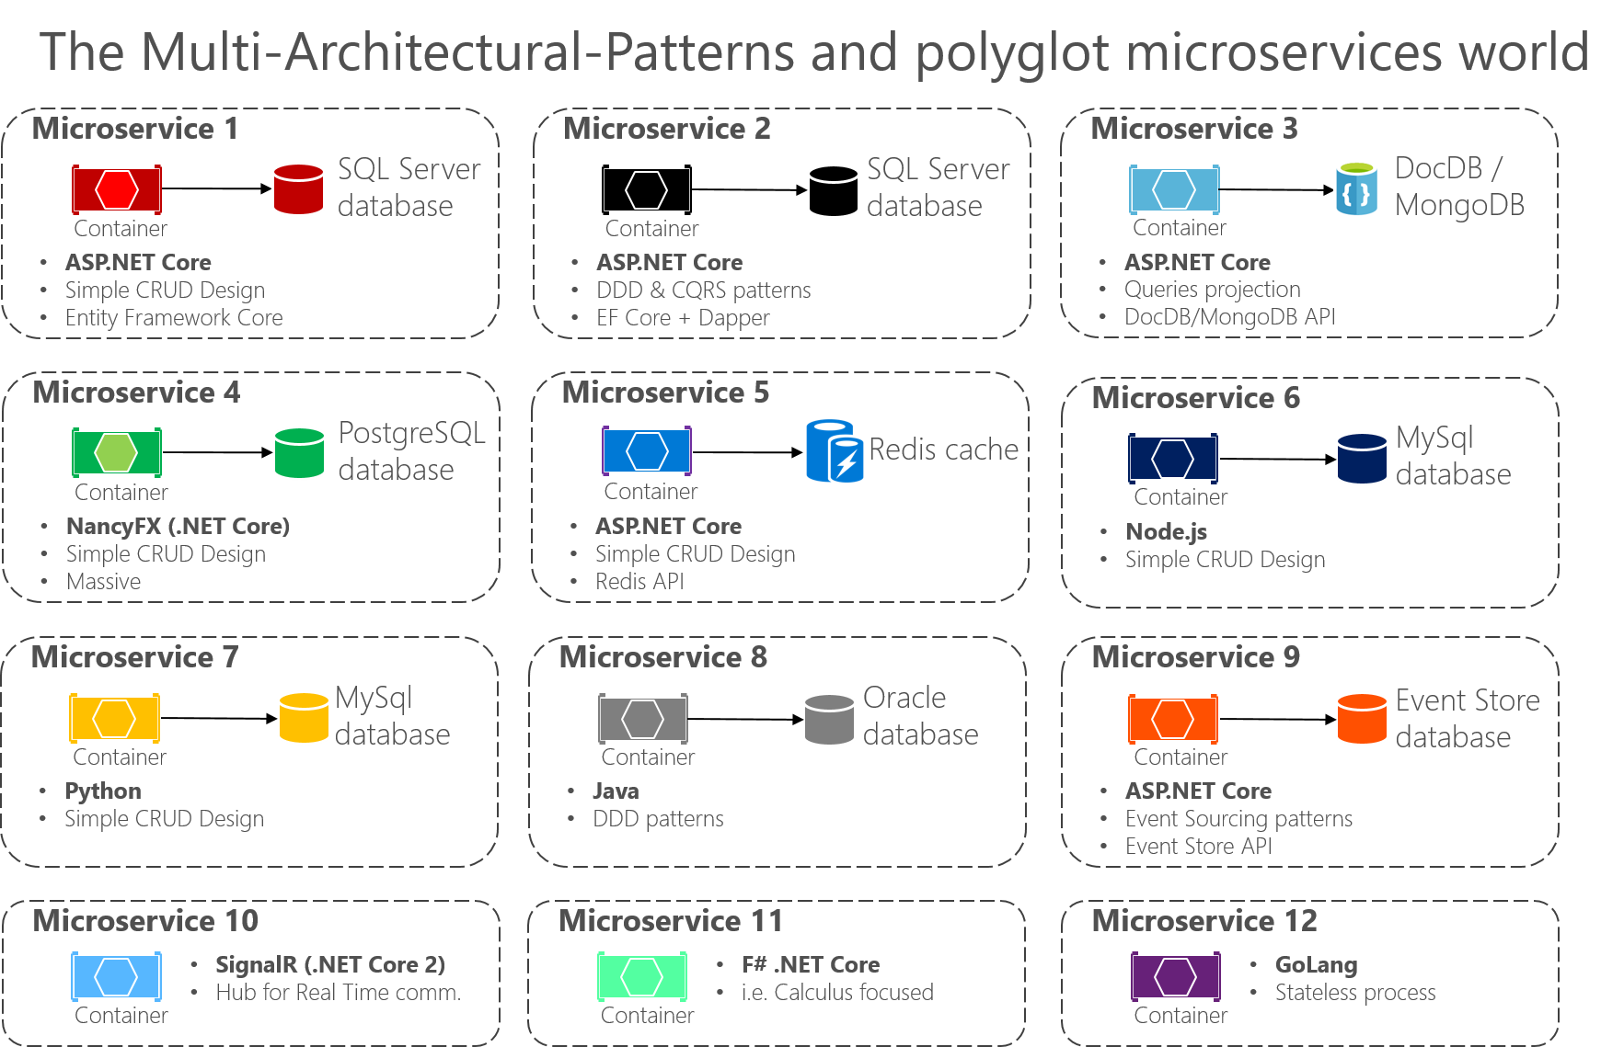
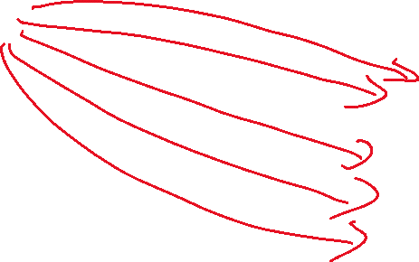
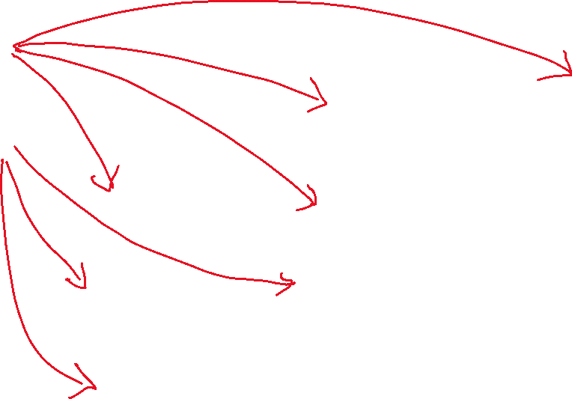
Resource Exhaustion

Slide 27
Code

Slide 28
Domain
Complexity

Slide 29
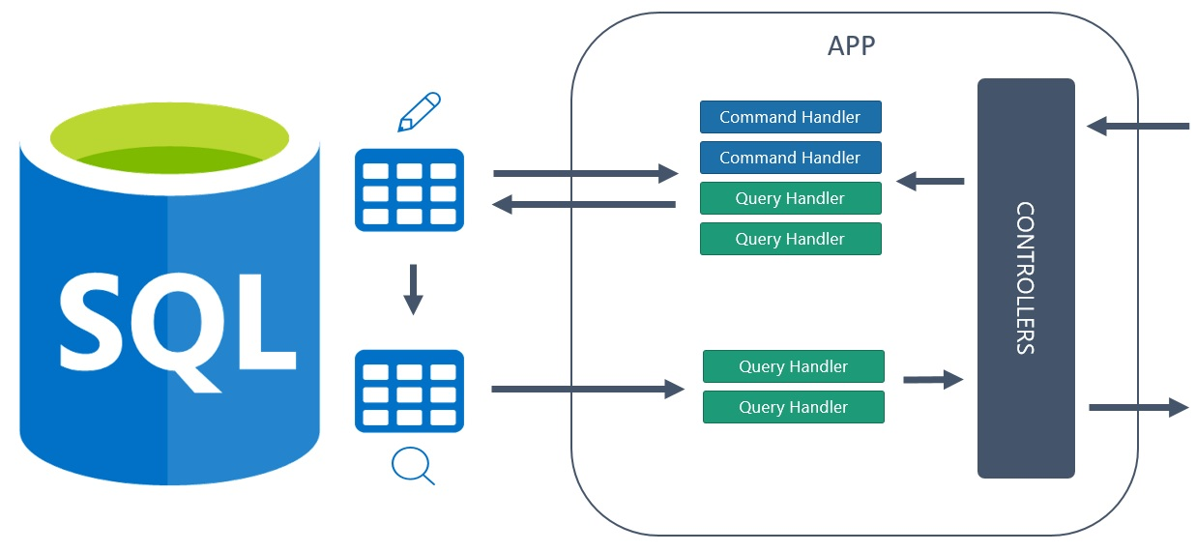
CQRS
Notes:
CQRS with Event Sourcing

Slide 30
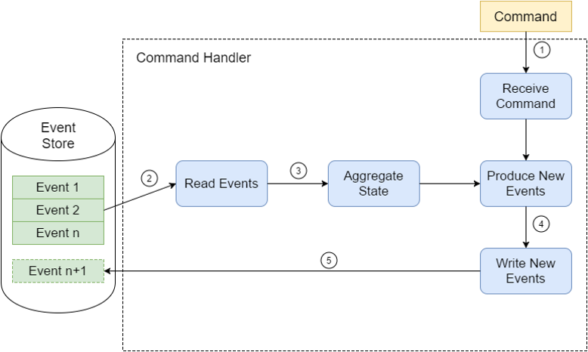
Event Sourcing

Slide 31
Code

